Slide 1



Embedded Systems: Kickoff semester 3

Slide 2
Semester planning – 6 sprints
Embedded project
1
2
3
4
5
6
7
8
9
10
11
12
13
14
15
16
17
18
sprint 1
GPIO, Interrupts, Low power proof of concepts
sprint 2 GPIO challenge
sprint 3 Timer, Watchdog
sprint 4
Timer challenge, FreeRTOS on STM32
sprint 5
Closed Loop System proof of concepts
sprint 6
Closed loop challenge

Slide 3
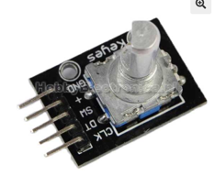
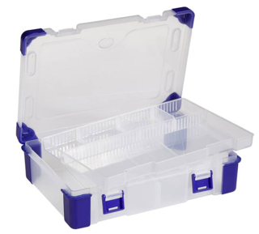
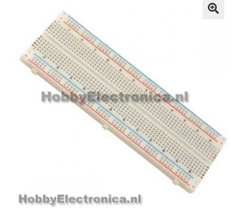
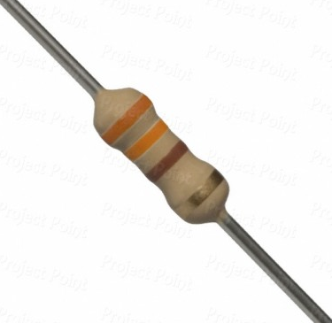

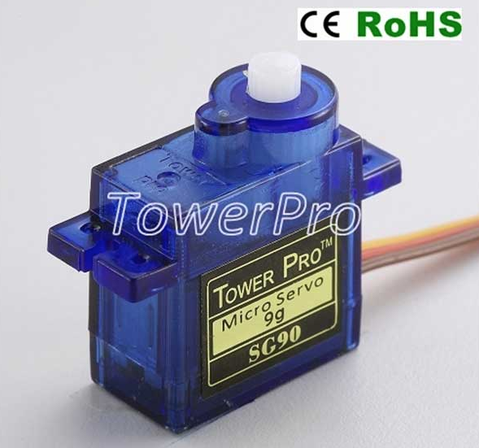
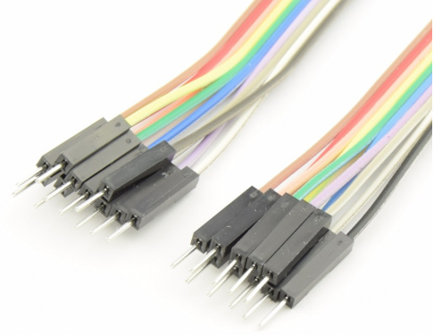
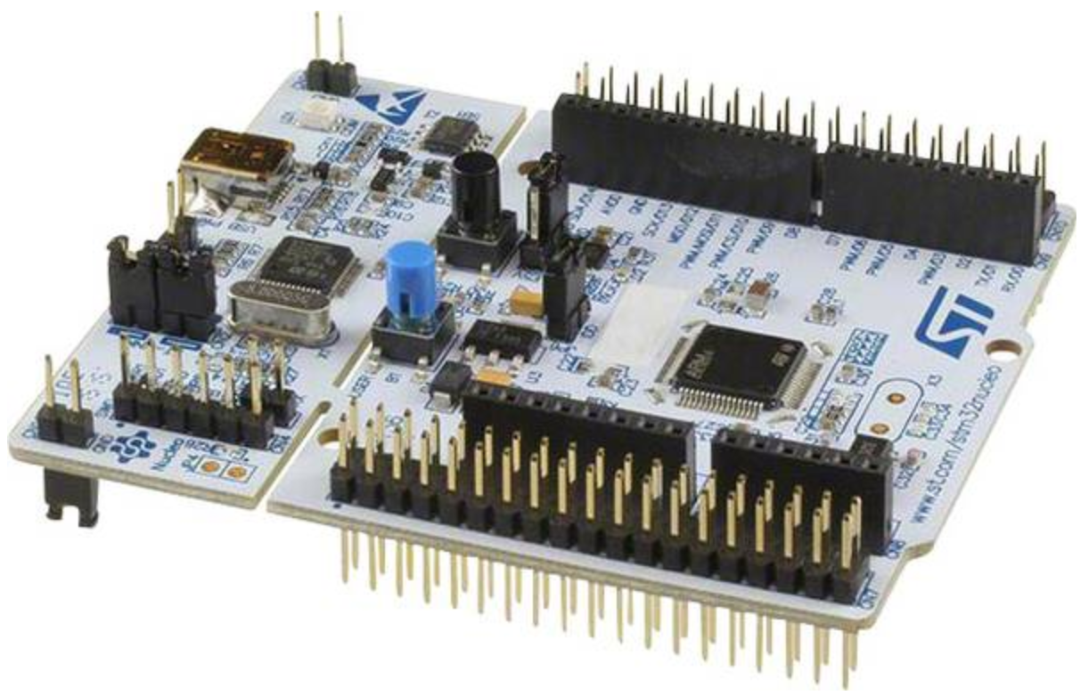
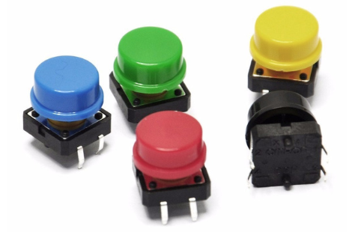
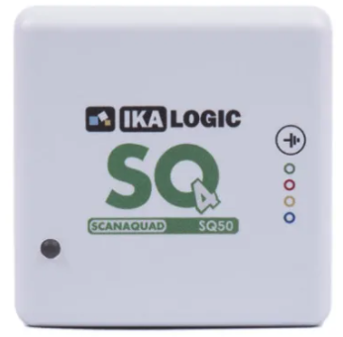
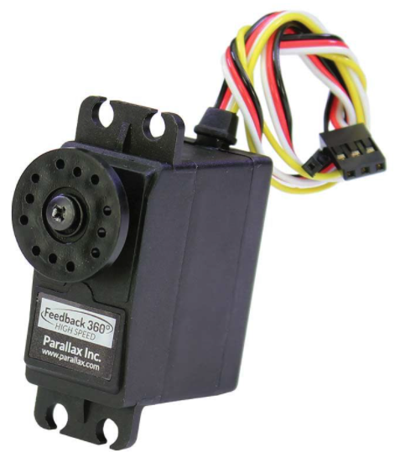
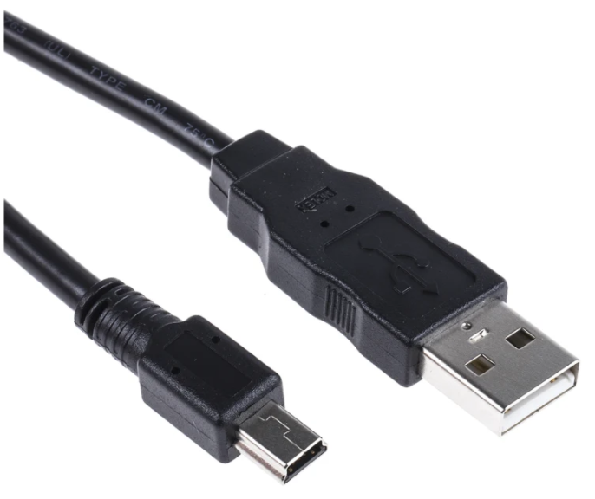
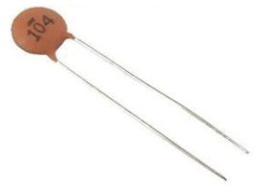
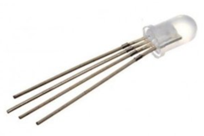
Course material - hardware

Slide 4
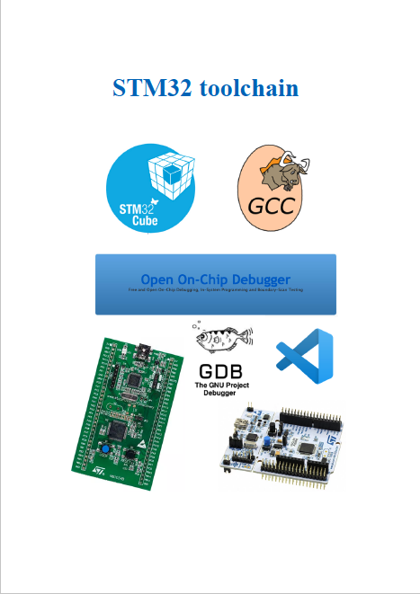
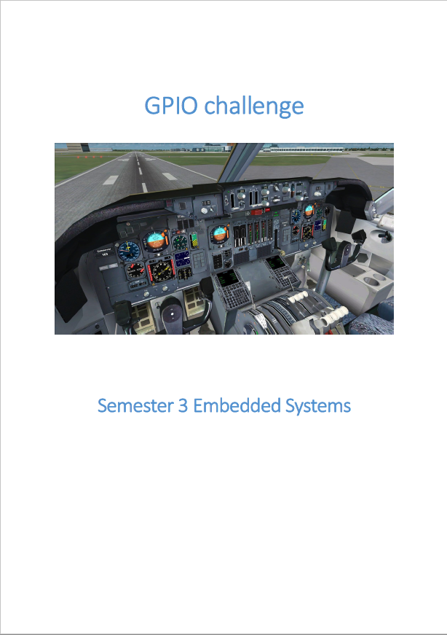
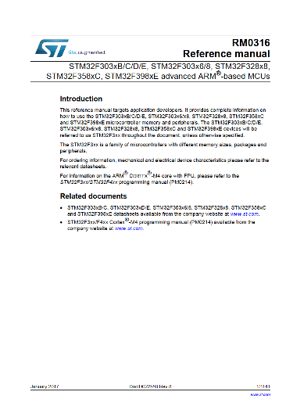
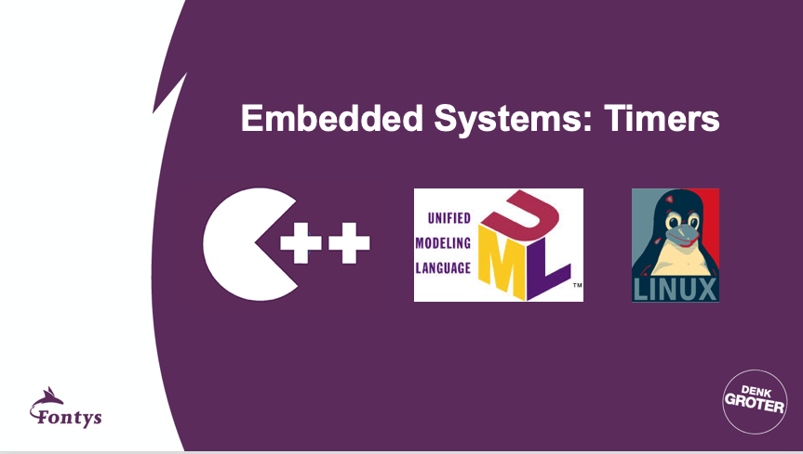
Course material – documents
Toolchain manual
Challenges
Data sheets
Presentations

Slide 5
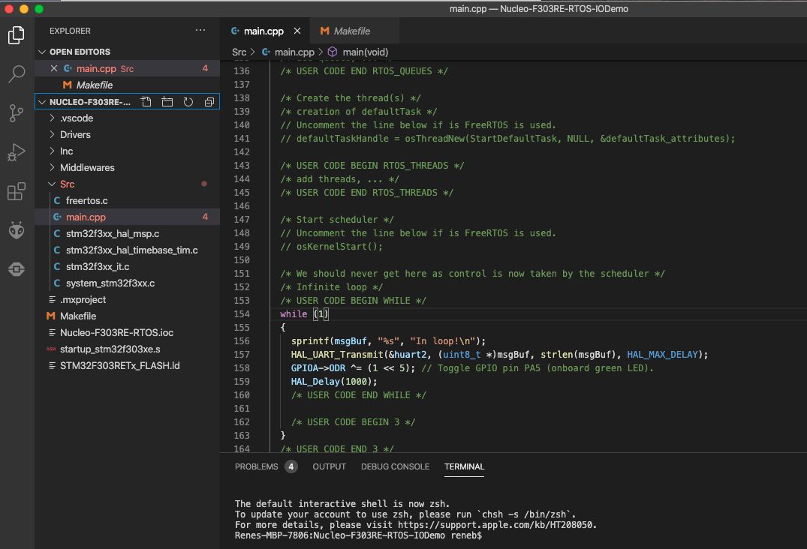
Course material – example program
Is a C++ project.
Is for the NUCLEO-F303RE board.
Has FreeRTOS included, but can also be used without using FreeRTOS.
Will blink the green LED on the NUCLEO-F303RE board and prints some text to the serial output every second.

Slide 6
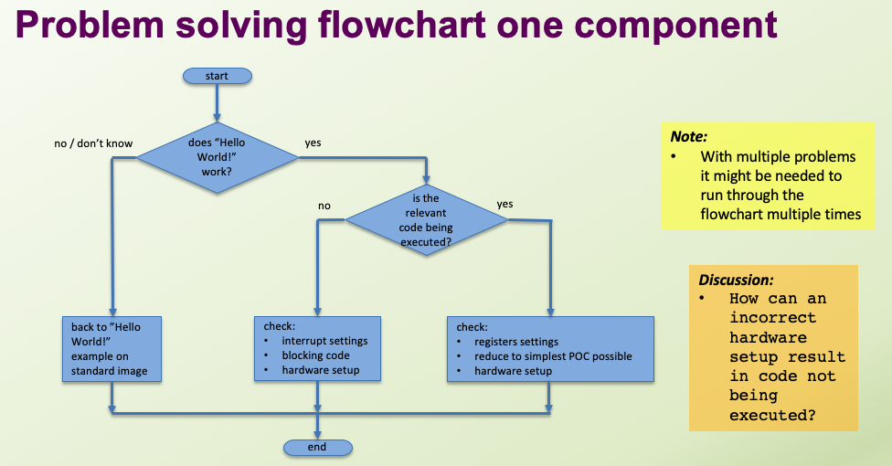
From the problem solving workshop
Tips
Do this workshop in the first sprint.
If a student has a problem, ask where he is in the flowchart and ask him to show this.

Slide 7
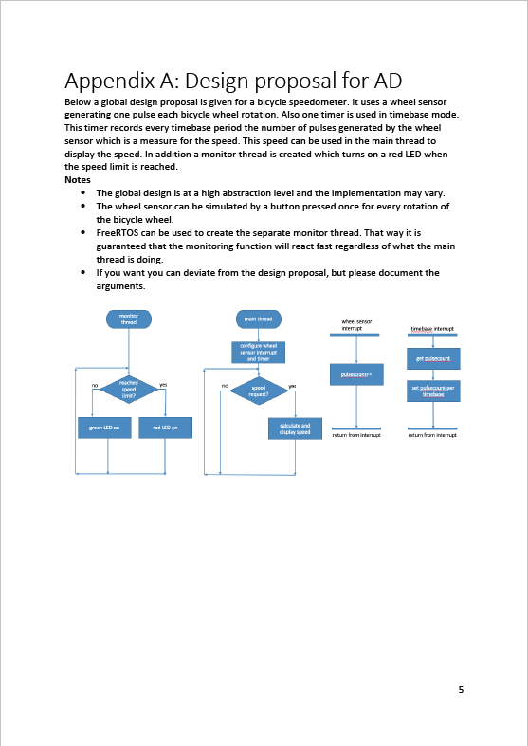
Global design provided for AD students
Notes
AD students do not have to carry out / document the research steps which would normally lead to a global design.
Instead AD students will be given a global design.
AD students will still have to fill in the detailed design of the separate components (UML).
Just implementing the global design is unsufficient for BA students because not all BA requirements will be covered.

Slide 8
Tips for retakers
Throw away your previous code / projects!
Make sure your VM is working without problems.
Work with C++ classes, deliver only clean code.
Take it step by step, small POC’s.

Slide 9
Questions?

